Slide 1
NUMERICAL METHODS
By
Dr. M. Mohamed Surputheen

Slide 2
Overview
Errors
Solution of algebraic and transcendental equations
Solution of Simultaneous linear algebraic equations
Interpolation
Numerical Integration
Numerical Solution of ordinary Differential Equations

Slide 3
ERRORS IN COMPUTATION
Defined as the difference between the true value in a calculation and the approximate value found using a numerical method etc.
Error (e) = True value – Approximate value.
Numerical methods yield approximate results that are close to the exact analytical solution.

Slide 4
Types of Errors
Round off error: Errors due to finite representation of numbers are called Round off Errors.
Numbers such as π, e, or √7 cannot be expressed by a fixed number of significant figures. Therefore, they can not be represented exactly by a computer which has a fixed word-length.
π = 3.1415926535….
Difference introduced by this omission of significant figures is called round-off errors.
Rounding a number can be done in two ways. One is known as chopping and other is known as rounding.
If π is to be stored on a base-10 system carrying 7 significant digits,
chopping : π=3.141592 error: ε_{t}=0.00000065
round-off: π=3.141593 error: ε_{t}=0.00000035
Some machines use chopping, because rounding has additional computational overhead.

Slide 5
Truncation Error: Errors due to finite representation of an inherently infinite process is called truncation errors. For example, the use of finite number of terms in the infinite series expansion of
Sinx = x - x³/3! + x⁵/5! – x⁷/7! +...
Cosx = 1-x+x²/2!-x⁴/4!+….
e^{x} = 1 + x + x²/2! + x³/3! + …
When we calculate these series, we cannot use all the term in series for computation. We usually terminate the process after a certain term is calculated. The terms “truncated” introduce an error which is called truncation error.

Slide 6
MEASURE OF ERRORS
Three ways of measuring the error are:
Absolute error
Relative error
Percentage error
If X is the true value of a quantity and X' is its approximate value, then
Absolute error: Absolute error is defined as
e_{a} = |True value – Approximate value|

Slide 7
MEASURE OF ERRORS
Relative error: Relative error is defined as:
Percentage error: Percentage error is defined as:

Slide 8
Examples
Suppose 1.414 is used as an approximation to
. Find the absolute, relative and percentage errors.

Slide 9
Examples
Example 2: If π = 22/7 is approximated as 3.14, then find the absolute, relative and percentage errors.

Slide 10
Solution of Algebraic and Transcendental Equations
Algebraic Equation: If f(x) is a polynomial in x, then f(x) = 0 is an algebraic equation.
Examples: x³ + 4x² – 1 = 0 , x⁴ + 5x³ – 6x² + 3x + 5 = 0, x² – 3x + 1 = 0
Transcendental Equation: If f(x) contains algebraic and non algebraic functions namely exponential, logarithmic and trigonometric functions then f(x) = 0 is called transcendental equation.
Examples: x + log x + sin x=0, xsinx+cosx=0, Xe^{x} -1 = 0

Slide 11
Direct and Iterative Methods
Direct Methods: These methods give the exact values of all the roots in a finite number of steps.
Direct methods require no knowledge of the initial approximation of a root of the equation f(x) = 0
Examples: solving quadratic equation, Synthetic division etc
Note: By using Directive Methods, it is possible to find exact solutions of the given equation.
Iterative Methods (Indirect Methods): These methods are based on the idea of successive approximations. We start with one or two initial approximations to the root and obtain a sequence of approximations.
Iterative methods require knowledge of the initial approximation of a root of the equation f(x) = 0
Examples: Bisection, False position, Newton-Raphson methods
Note: By using Iterative methods, it is possible to find approximate solution of the given equation .

Slide 12
Need for iterative Methods
The value of x which satisfying the equation f ( x) = 0 is called the root of the equation.
If f(x) is a quadratic, cubic or a biquadratic expression, then algebraic formulae are available to obtain the roots .
If f(x) is a polynomial of higher degree or an expression involving transcendental functions then algebraic methods are not available.
So these types of equation can be solved by iterative methods such as
Bisection Method
False position Method
Newton-Raphson Method
Iteration Method

Slide 13
Two Fundamental Approaches
BRACKETING METHOD
The bracketing methods require the limits between which the root lies.
Examples: Bisection and False Position Methods
OPEN METHOD
The open methods require the initial estimate of the solution.
Examples: Newton – Raphson And Method of successive approximation methods

Slide 14
Procedure for Bisection Method
Find an interval [x₀ ,x₁] so that f(x₀)f(x₁) < 0
Find x₂ = (x₀+x₁)/2.
If f(x₂) = 0, then x₂ is the root of the equation.
If f(x₂) ≠ 0 and f(x₀)f(x₂) < 0, root lies in [x₀,x₂].
Otherwise root lies in [x₂,x₁].
(ie) If f(x₂) ≠ 0 and f(x₀)f(x₂) > 0 then x₀ =x₂ else x₁=x₂
We continue this process until we find the root (i.e., x₂ = 0), or the latest interval is smaller than some specified tolerance.

Slide 15
Examples:
1) Find a real root of the equation x³-2x-5=0 using Bisection method
Let f(x)= x³-2x-5=0
f(2)=-1 and f(3)=16 i.e. A root lies between 2 and 3.
Condition for the next iteration
If sign(f0) = sign(f2) then x0=x2; else x1=x2;
_____________________________________________________________
Iteration x0 x1 x2 f0 f1 f2
_____________________________________________________________
1 2.000 3.000 2.500 -1.000 16.000 5.625
2 2.000 2.500 2.250 -1.000 5.625 1.891
3 2.000 2.250 2.125 -1.000 1.891 0.346
4 2.000 2.125 2.062 -1.000 0.346 -0.351
5 2.062 2.125 2.094 -0.351 0.346 -0.009
_____________________________________________________________
App.root = 2.094

Slide 16
2) Find one root of e^{x} – 3x = 0 correct to two decimal places using the method of Bisection.
f (x) = e^{x} – 3x
f (1) = e¹ – 3(1) = –0.283
f (2) = e² – 3(2) = 1.389
a root lies between 1 and 2
Condition for the next iteration
If sign(f0) = sign(f2) then x0=x2; else x1=x2;
_________________________________________________________________
Iteration x0 x1 x2 f0 f1 f2
__________________________________________________________________
1 1.000 2.000 1.500 -0.282 1.389 -0.018
2 1.500 2.000 1.750 -0.018 1.389 0.505
3 1.500 1.750 1.625 -0.018 0.505 0.203
4 1.500 1.625 1.562 -0.018 0.203 0.083
5 1.500 1.562 1.531 -0.018 0.083 0.030
6 1.500 1.531 1.516 -0.018 0.030 0.005
_________________________________________________________________
App.root = 1.516

Slide 17
3. Find the two roots of the equation xsinx+cosx=0 using Bisection method
f(x)= xsinx+cosx=0
f(2)= 2sin2+cos2 = 1.402
f(3)= 3sin3+cos3 = -0.567
a root lies between 2 and 3.
Condition for the next iteration
If sign(f0) = sign(f2) then x0=x2; else x1=x2;
__________________________________________________________________
Iteration x0 x1 x2 f0 f1 f2
___________________________________________________________________
1 2.000 3.000 2.500 1.402 -0.567 0.695
2 2.500 3.000 2.750 0.695 -0.567 0.125
3 2.750 3.000 2.875 0.125 -0.567 -0.207
4 2.750 2.875 2.812 0.125 -0.207 -0.037
5 2.750 2.812 2.781 0.125 -0.037 0.045
6 2.781 2.812 2.797 0.045 -0.037 0.004
___________________________________________________________________
App.root = 2.797

Slide 18
f(x)= xsinx+cosx=0
f(-2)= -2sin(-2)+cos(-2) = 1.402
f(-3)= -3sin(-3)+cos(-3) = -0.567
Another root lies between -2 and -3.
__________________________________________________________________
iteration x0 x1 x2 f0 f1 f2
___________________________________________________________________
1 -2.000 -3.000 -2.500 1.402 -0.567 0.695
2 -2.500 -3.000 -2.750 0.695 -0.567 0.125
3 -2.750 -3.000 -2.875 0.125 -0.567 -0.207
4 -2.750 -2.875 -2.812 0.125 -0.207 -0.037
5 -2.750 -2.812 -2.781 0.125 -0.037 0.045
6 -2.781 -2.812 -2.797 0.045 -0.037 0.004
____________________________________________________________________
App.root = -2.797

Slide 19
Bisection Method
Advantages:
Simple and easy to implement
One function evaluation per iteration
No knowledge of the derivative is needed
Disadvantages:
We need two initial guesses a and b which bracket the root.
Slowest method to converge to the solution.
When an interval contains more than one root, the bisection method can find only one of them.

Slide 20
Procedure for False Position Method
Locate the interval [x₀, x1] in which root lies.
First Approximation to the root using
If f(x₂) = 0, x₂ is the root.
4. If f(x₂) ≠ 0 and f(x₀)f(x₂) > 0 then x₀ =x₂ else x₁=x₂
5. Repeat the process until the root converges.

Slide 21
False Position Method
Advantages:
1. Simple
2. Brackets the Root
Disadvantages:
1. Can be slow
2. Like Bisection, need an initial interval around the root.

Slide 22
Example1:
Compute the roots of the equation x³-4x-9=0 by Regula Falsi method.
Given f(x)= x³-4x-9=0
f(2)= 2³-4x2-9= -9
f(3)= 3³-4x3-9= 6
_________________________________________________________________
x0 x1 x2 f0 f1 f2
_________________________________________________________________
2.000000 3.000000 2.600000 -9.000000 6.000000 -1.824002
2.600000 3.000000 2.693252 -1.824002 6.000000 -0.237225
2.693252 3.000000 2.704918 -0.237225 6.000000 -0.028912
2.704918 3.000000 2.706333 -0.028912 6.000000 -0.003497
_________________________________________________________________
App.root = 2.706333

Slide 23
Example2:
using regula falsi method find a real root of the equation xlog₁₀x-1.2=0 correct up to 3 places of decimals
f(x)= xlog₁₀x-1.2
f(1)= 1log₁₀1-1.2 =-1.2
f(2)= 2log₁₀2-1.2= -0.597940
f(3)= 3log₁₀3-1.2=0.231364
_______________________________________________________________
x0 x1 x2 f0 f1 f2
_______________________________________________________________
2.000000 3.000000 2.721014 -0.597940 0.231364 -0.017091
2.721014 3.000000 2.740206 -0.017091 0.231364 - 0.000384
________________________________________________________________
App.root = 2.740206

Slide 24
False Position Method
Advantages:
1. Simple
2. Brackets the Root
Disadvantages:
1. Can be slow
2. Like Bisection, need an initial interval around the root.

Slide 25
Procedure for Newton-Raphson Method
Locate the initial value x₀.
Evaluate
Use an initial guess of the root, x₀, to estimate the new value of the root, x₁, as
If f(x1) = 0, x₁ is the root.
If f(x₁) ≠ 0 then x₀ =x₁
Repeat the process until the root converges.

Slide 26
Newton-Raphson method - Examples
Example1: Find a real root of the equation f(x)=x³ -2x-5=0 using Newton –raphson method.
Given
f(2)=2³ -2x2-5= -1
f(3)=3³ -2x3-5= 16
choose x₀ ₌ 2 f’(x) = 3x²-2
________________________________________________________
x0 f(x0) f'(x0) x1 f(x1)
_______________________________________________________
2.000000 -1.000 10.000000 2.100000 0.060999
2.100000 0.060999 11.229999 2.094568 0.000185
_______________________________________________________
App.root = 2.094568

Slide 27
Find the root of the equation f(x)=3x-cosx-1=0
F’(x)= 3+sinx
The root lies between 0 and 1
______________________________________________
x0 f(x0) f'(x0) x1 f(x1)
______________________________________________
0.000000 -2.000 3.000000 0.666667 0.214113
0.666667 0.214113 3.618370 0.607493 0.001397
_____________________________________________
App.root = 0.607493

Slide 28
Evaluate √l2 to three decimal places using Newton-Raphson method.
X= √l2 or x= √12 or x²-12
f(x)=x²-12 =0
f(3) =-3 and f(4)=4
f’(x) =2x
a root lies between 3 and 4.
Choose x0=4
____________________________________________
x0 f(x0) f'(x0) x1 f(x1)
______________________________________________
4.000000 4.0000 8.000000 3.500000 0.25000
3.500000 0.25000 7.000000 3.464286 0.001276
____________________________________________
The approximate root is 3.464286

Slide 29
Find a real root of the equation f(x)=xe^{x} -1 =0
F’(x)= (1+x)e^{x}
Root lies between 0 and 1. Choose x0 =1
_______________________________________________________________
x0 f(x0) f'(x0) x1 f(x1)
_______________________________________________________________
1.000000 1.71828 2 5.436563 0.683940 0.355342
0.683940 0.355342 3.337012 0.577454 0.028734
0.577454 0.028734 2.810231 0.567230 0.000239
____________________________________________________________
App.root = 0.567230

Slide 30
Newton-Raphson Method
Advantages:
Converges fast, if it converges and requires only one guess
The method is quadratically convergent, that is the number of decimal places of accuracy nearly doubles at each iteration
Starting point can be arbitrary
Disadvantages:
The Newton-Raphson method requires the calculation of the derivative of a function, which is not always easy.
If f' vanishes at an iteration point, then the method will fail to converge.

Slide 31
Method of successive approximation or Fixed Point Iteration method
Consider the equation f(x) = 0
Rewrite the equation f(x) = 0 in the form x = g(x).
If the initial approximation is x₀ , then calculate
x₁ ₌ g(x₀)
x₂ = g(x₁)
x₃ = g(x₂)
x₄ = g(x₃) … and so on ..
X_{i+1} = g(x_{i})
Theorm
If g(x) and g'(x) are continuous on an interval containing a root of the equation g(x) = x, and if |g'(x)| < 1 for all x in the interval then the series x_{n+1} = g(x_{n}) will converge to the root.

Slide 32
Iteration Method: Convergence Conditions
Convergence of x_{n+1} = g(x_{n}), when | g ′ (x) | < 1
x_{n+1} = g(x_{n}) oscillates but ultimately converges, when | g ′ (x) | < 1, but g ′ (x) < 0
x_{n+1} = g(x_{n}) diverges, when g ′ (x) > 1

Slide 33
Procedure for fixed point Iteration
Re-write f (x) = 0 as x = g(x)
Start with an initial guess x0
find ⎢g′(x1) ⎢ , if ⎢g′(x1) ⎢ < 1.
Compute x1, x2, x3, . . . Using xi+1 = g(xi )
Repeat step 4 several times until convergence is achieved.

Slide 34
Iteration Method: Example2
Find a real root of the equation f(x)= x³+x²-1 = 0
using iteration method.
f(0) = -1 and f(1) =1.
A root lies between 0 and 1,
Rewrite g(x)
x³ + x² - 1=0
or, x³ + x² = 1
or, x²(x+1) = 1
or, x² = 1/(x+1)
or, x = 1/√(x+1)
x = g(x)=1/√(x+1)
g(x)=1/√(x+1)
Let, x₀ =1
The required root is 0.7548
x₀ = 1.00000
x₁ = 0.70711
x₂ =0. 76537
x₃ = 0.75263
x₄ = 0.75536
x₅ = 0.75477
x₆ = 0.75487
x₇ = 0.75487

Slide 35
Example 3:Find the root of the equation 2x = cosx + 3 correct to three decimal places.
The given can be written as
f(x)=cosx+3-2x
f(0)=4,f(1)= 1.5403,f(2)=-1.4161, Let x₀=1
x₀ = 1.0000
x₁ = 1.7702
x₂ = 1.4010
x₃ = 1.5845
x₄ = 1.4931
x₅ = 1.5388
x₆ = 1.5160
x₇ = 1.5274
x₈ = 1.5217
x₉ = 1.5245
x₁₀ = 1.5231
Hence the iteration method can be applied to the given equation..
The Root is 1.5231

Slide 36
Iterative Method: Drawbacks
We need an approximate initial guesses x₀.
It is also a slower method to find the root.
If the equation has more than one roots, then this method can find only one of them.

Slide 37
Solution of linear algebraic equations
A system of m linear equations (or a set of n simultaneous linear equations) in ‘n’ unknowns x₁,x₂,x₃…x_{n} is a set of equations of the form,
The system can be written in a matrix format as Ax = b, when

Slide 38
Two approaches for solving systems of linear equations
1.Direct Methods
direct methods solve a system of linear equations in a finite number of steps.
The solution do not contain any truncation errors.
These direct techniques are useful when the number of equations involved is not too large .
Examples of direct methods: Gauss Elimination and Gauss-Jordan Elimination.
2.Iterative Methods
These methods require an initial approximation of the solution. Then the successive approximations are obtained till they reach some accepted level of accuracy. The solution contains truncation error.
These iterative methods are more appropriate when the number of equations involved is large or when the matrix is sparse.
Examples of iterative methods: Jacobi method and Gauss Seidel iterative methods

Slide 39
Gauss Elimination method
Gauss elimination is the most important algorithm to solve systems of linear equations.
In gauss elimination method, the given system of linear equations is converted to upper triangular system by elimination of variables. The upper triangular system is then solved by backward substitution.
Consider the following three simultaneous equations in 3 unknowns

Slide 40
1. Write the augmented matrix for the system of linear equations.
2. Forward elimination of unknowns. Use elementary row operations on the augmented matrix to transform the matrix into upper triangular form. If a zero is located on the diagonal, switch the rows until a nonzero is in that place.
3.Use back substitution to find the solution of the problem.

Slide 41
1. Write the augmented matrix for the system of linear equations
An augmented matrix is a matrix containing the coefficients and constants from a system of equations.
The augmented Matrix of the above system is
2.Triangularization or Forward elimination of unknowns.

Slide 42
3.Back substitution.
Back-substitution is the process of solving a system by beginning with the last equation, sequentially moving up through all the equations, and using each equation to solve for one variable at a time.
Starting with the last row, solve for the unknown, then substitute that value into the next highest row.
Because of the upper-triangular nature of the matrix, each row will contain only one more unknown.

Slide 43
Examples
Apply Gauss elimination method to solve the equations
Solution
The augmented Matrix of the above system is

Slide 44
The above matrix becomes
Eliminating X₂ from Equation 2

Slide 45
Back substitution

Slide 46
Solve the following system of equations by Gauss elimination method
Eliminate x from the second and third equations

Slide 47
Eliminate y from the third equation
By back substitution

Slide 48
Pitfalls in Gauss elimination
1.Pivoting
2. Ill-cnditioned equations.
1.Pivoting: In each step of the elimination procedure, the diagonal element a_{ii} is called pivot element.
If a pivot element is zero or close to zero, elimination step leads to division by zero. In such situation, we rewrite the equations in different order to avoid zero pivot.
Changing the order of equations to avoid zero element on the diagonal is called pivoting.
If a_{ii} = 0, we interchange the ith row (called the pivot row) with any other row below it, preferably with the row having numerically greatest element in the ith column. This process of interchange of rows of the coefficient matrix is called pivoting.

Slide 49
Example using pivoting
Solve by gauss elimination method
The augmented matrix is

Slide 50
Now the row can not be used as a pivot row, ass a₂₂=0, interchange second and third rows, we obtain

Slide 51
Ill-conditioned systems
Ill-conditioned systems:
A system of linear equations is said to be ill-conditioned when small variation in the system can produce large changes in the exact solution. Otherwise, the system is said to be well conditioned.
Since round off errors can induce small changes in the coefficients, these changes can lead to large solution errors.

Slide 52
Example: Verify the following two systems are well conditioned or not
Here a change of .00002 in a₂₂ and .00001 in a₂₃ has caused a gross change in the solution.
Therefore, the given two systems are ill conditioned systems.

Slide 53
Four variables Gauss elimination
To eliminate elements from first column
a₁₁ is the pivot, to eliminate elements from second column a₂₂ is the pivot etc.

Slide 54
Solve by Gauss Elimination method
The augmented matrix is

Slide 55
Eliminate x1 from equations 2,3 and 4
Eliminate x₂ from equations 3 and 4
Eliminate x₃ from equation 4

Slide 56
Backward Substitution

Slide 57
Example 2 :Solve by Gauss elimination Method
The augmented Matrix is

Slide 58
Eliminating x₂ from equations 3 and 4
For using next step a₃₃=0, interchange row 3 and row 4, we get
By back substitution
X₁=0,x₂=1,x₃=-1 and x₄=2

Slide 59
Gauss-Jordan method
This method is a modified from Gaussian elimination method.
In this method, the coefficient matrix is reduced to a diagonal matrix rather than a triangular matrix as in the Gaussian method.
Here the elimination of the unknowns is done not only in the equations below, but also in the equations above the leading diagonal.
Here we get the solution without using the back substitution method

Slide 60
Gauss-Jordan Elimination Steps
Write the augmented matrix for the system of linear equations.
Use elementary row operations on the augmented matrix A to transform A into diagonal form. If a zero is located on the diagonal, switch the rows until a nonzero is in that place.
By dividing the diagonal element and the right-hand-side element in each row by the diagonal element in that row, make each diagonal element equal to one.

Slide 61
Given a system of equations
Write the augmented matrix for the system of linear equations.
Convert the augmented matrix into a diagonal matrix

Slide 62
The new matrix is
3.By dividing each row by the diagonal element in that row, make each diagonal element equal to one.

Slide 63
Example1:
Solve the following system of equations by gauss Jordan method.
2x₁ + x₂ +4x₃ = 12
8x₁ -3x₂ + 2x₃ = 20
4x₁ +11x₂ - x₃ = 33
The Augmented Matrix is

Slide 66
Example2:
Solve the following system of equations by gauss Jordan method.
3x₁ – 2x₂ – 3x₃ = –16
2x₁ + 4x₂ + x₃ = 15
x₁ – 7x₂ + x₃ = –8
The augmented Matrix is

Slide 67
Eliminating x₁ from 2nd and 3rd equations
Eliminating x₂ from 3rd equation

Slide 70
Gauss-Seidel Iterative Method
Iterative methods provide an alternative to the elimination methods. The Gauss-Seidel method is the most commonly used iterative method.
The system [A]{X}={B} is reshaped by solving the first equation for x₁, the second equation for x₂, and the third for x₃, …and n^{th} equation for x_{n}.

Slide 71
Gauss-Siedel
Now we can start the solution process by choosing guesses for the x’s. A simple way to obtain initial guesses is to assume that they are zero. These zeros can be substituted into x₁ equation to calculate a new x₁=b₁/a₁₁.
New x₁ is substituted to calculate x₂ and x₃. The procedure is repeated until the convergence criterion is satisfied

Slide 72
Convergence of Gauss-Seidel iteration
GS iteration method converges for any initial vector if the coefficient matrix A is a Diagonally Dominant matrix
Diagonally dominant: the magnitude of the diagonal element is larger than the sum of absolute value of the other elements in the row
(or)
Diagonally dominant: The coefficient on the diagonal must be at least equal to the sum of the other coefficients in that row and at least one row with a diagonal coefficient greater than the sum of the other coefficients in that row.

Slide 73
The given system
The Coefficient Matrix is
Diagonally dominance means
If the coefficient matrix is not diagonally dominant , we have to rearrange the equations to satisfy the condition. Otherwise the convergence of this method is not assured.
Note that this is not a necessary condition, i.e. the system may still have a chance to converge even if A is not diagonally dominant.

Slide 74
Solve by Gauss Seidel method
In the given system, the coefficient matrix is diagonally dominant. There fore no need to interchange the equations.
The given equations may be rewritten as

Slide 75
For the First Iteration, Put x₁=x₂=x₃=0 in the given system,
The solution is x1=1, x2=-1 and x3=1
Iteration | X₁ | X₂ | X₃
1 2 3 | 0.85000 1.0025 1.0000 | -1.0275 -0.9998 -1.0000 | 1.09109 -0.9998 1.0000

Slide 76
Solve By gauss elimination method with initial guess x₁=1 , x₂ =0 and x₃ =1
Here the coefficient matrix is
not diagonally dominant, if
We proceed as it is it will diverge.
Rearrange the equations to convert the above Matrix
to diagonally dominant (swap 1st and 3rd equations).
The new Matrix is

Slide 77
The arranged equations are
Start with an initial guess x₁=1 , x₂ =0 and x₃ =1
The above equations can be rewritten as

Slide 78
Repeating more iterations, the following values are obtained
The solution is
Iteration | x₁ | x₂ | x₃
1 2 3 4 5 6 | 0.50000 0.14679 0.74275 0.94675 0.99177 0.99919 | 4.900 3.7153 3.1644 3.0281 3.0034 3.0001 | 3.0923 3.8118 3.9708 3.9971 4.0001 4.0001

Slide 79

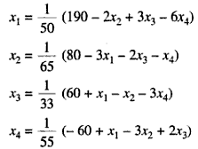
Example 3 :Solve by Gauss Seidel method
The coefficient Matrix is not diagonally dominant, Interchange equation 2nd and 4th equation and rewrite the new system in required form

Slide 80
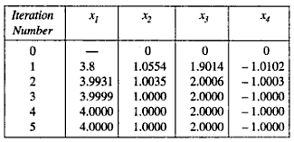
Substitute x₂=x₃=x₄=0 initially and the values of x₁,x₂,x₃ and x₄ got after successive iterations are given in the following table.
Therefore the required solution of the system is x₁=4, x₂=1,x₃=2 and x₄=-1

Slide 81
Interpolation
Introduction
Interpolation is a process of computing intermediate values of an unknown function f(x) from a set of given values of that function.(or)
Interpolation is the process of using known data values to estimate unknown data values.
Suppose we are given the following values of y = f( x) for a set of values of x:
The process of finding the value of y corresponding to any value of x = x _{i} between x ₀ and x _{n} is called interpolation.
The process of computing the value of the function outside the given range is called extrapolation.
Inverse interpolation is the process of finding the value of x corresponding to a value of y, which not given in the table.

Slide 82
Finite differences
Suppose that the function y = f(x) is tabulated for the equally spaced values x = x₀, x₀ + h, x₀ + 2h, ....., x₀ + nh, giving y = y0, y1, y2, ......, yn.
(ie) Given the following table with the condition
x _{n}=x₀+nh
To determine the values of f(x) for some intermediate values of x, the following two types of differences are useful:
1. Forward differences
2.Backward differences

Slide 83
Forward Differences
If y₀, y₁, y₂, ..., y_{n} denote a set of values of any function y = f(x), then y₁ - y₀, y₂ - y₁, y₃ - y₂, ..., y_{n} - y_{n-1} are called the differences of the function y.
We denote these differences by Δy₀, Δy₁, Δy₂ etc., where
Δy₀ = y₁ - y₀,
Δy₁ = y₂ - y₁, ...,
Δy_{n-1} = y_{n} - y_{n-1},
Δy_{n} = y_{n+1} - y_{n}.
Here, Δ is called the forward difference operator and Δy₀, Δy₁, Δy₂, ..., Δy_{n} are called first forward differences.

Slide 84
Forward Differences
The differences of these first forward differences are called second forward differences and are denoted by
Δ²y₀ ₌ Δy₁ - Δy₀ ,
Δ²y₁ = Δy₂ - Δy₁,etc.
Similarly, one can define third forward differences, fourth forward differences, etc.

Slide 85
Forward Differences

Slide 86
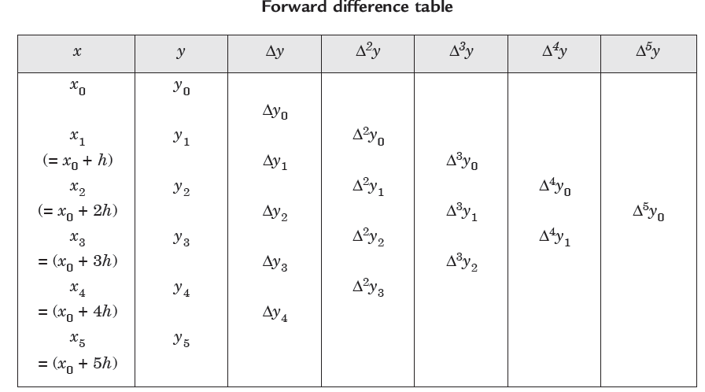
Forward difference table

Slide 87
Backward Differences
The differences y₁ - y₀, y₂ - y₁, ..., y_{n} - y_{n-1} are called Backward or Horizontal Differences, if they are denoted by ∇y₁, ∇y₂, ..., ∇y_{n}
Here, ∇y₁ = y₁ - y₀, ∇y₂ = y₂ - y₁, ...∇y_{n} = y_{n} - y_{n-1},
∇ is called the backward difference operator.
In a similar way, one can define backward differences of higher orders.
Thus we obtain,

Slide 88
Newton’s formula for Forward Interpolation
The reason for the name “forward” interpolation formula since the formula contains values of the tabulated function from y₀ onward to the right (forward from y₀) and none to the left of this value.
Because of this fact this formula is used mainly for interpolating the values of y near the beginning of a set of tabular values.

Slide 89
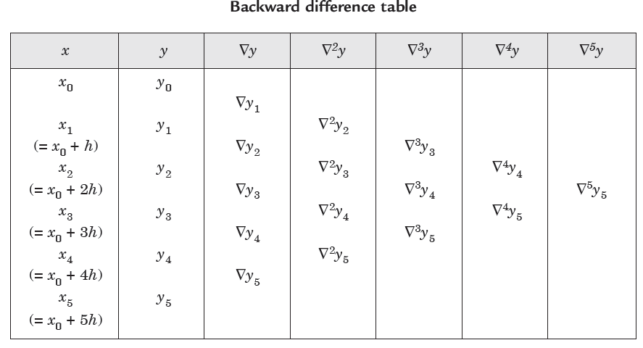
Backward difference table

Slide 90
Newton’s formula for Backward Interpolation
The reason for the name “backward” interpolation formula since the formula contains values of the tabulated function from y_{n} onward to the left (backward from y_{n}) and none to the right of this value.
Because of this fact this formula is used mainly for interpolating the values of y near the end of a set of tabular values.

Slide 91
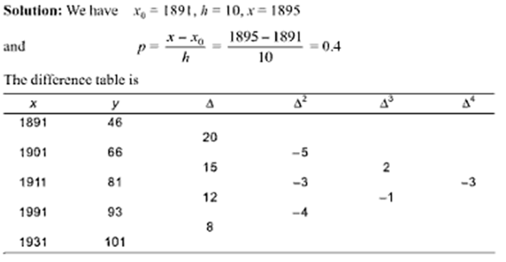
Newton’s Forward difference interpolation formula :Example 1
The population of a town is given below for a range of years. Estimate the population for the year 1895.
Year : x | 1891 | 1901 | 1911 | 1921 | 1931
Population: y (in thousands) | 46 | 66 | 81 | 93 | 101

Slide 92
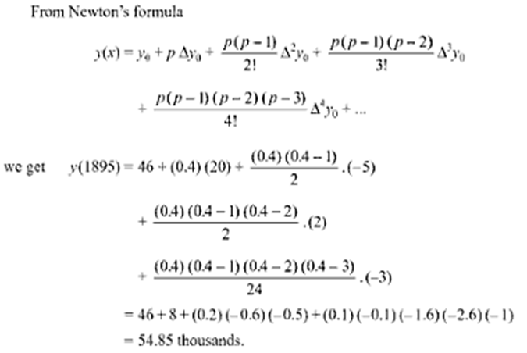

Slide 93
Example 2
Find the cubic polynomial which takes the following values
y(0) = 1, y(1) = 0, y(2) = 1 and y(3) = 10
Hence, or otherwise obtain y(4).
Solution. Here x0=0,h=1 p=x-x0/h
x | y | Δ | Δ² | Δ³
0 | 1
 |  | -1
1 | 0 |  | 2
 |  | 1 |  | 6
2 | 1 |  | 8
 |  | 9
3 | 10

Slide 94
Example 2 Cont.
Newton’s forward difference interpolation formula is
x | y | Δ | Δ² | Δ³
0 | 1
 |  | -1
1 | 0 |  | 2
 |  | 1 |  | 6
2 | 1 |  | 8
 |  | 9
3 | 10
Therefore, the polynomial we obtained for the given tabular values is.
Now,
y(4) = (4)³ – 2*(4)² +1 = 33
This is an extrapolation

Slide 95
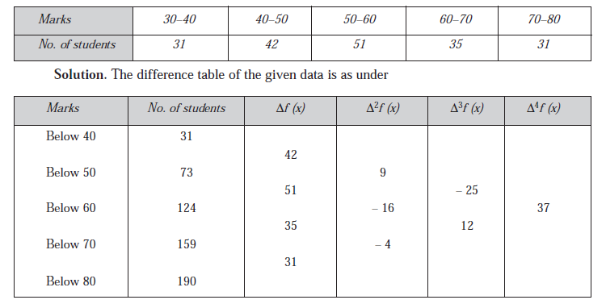
Example 3:From the following table, find the number of students who obtain less than 45 marks.

Slide 96
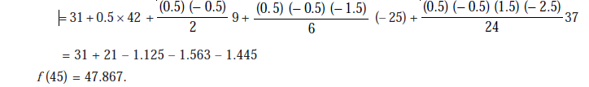
Newton’s forward difference interpolation formula is
Where P=x-x0/h = 45-40/10=0.5
= 48 students.

Slide 97
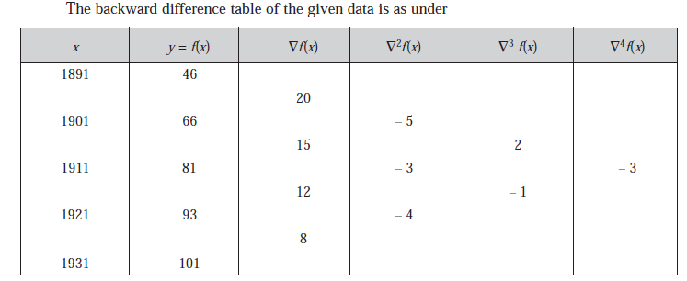
Newton’s backward difference formula :Example 1
The population of a town is given below for a range of years. Estimate the population for the year 1925.
The value 1925 is near the end of the table, Therefore we use Newton’s backward difference interpolation formula.
Year : x | 1891 | 1901 | 1911 | 1921 | 1931
Population: y (in thousands) | 46 | 66 | 81 | 93 | 101

Slide 98
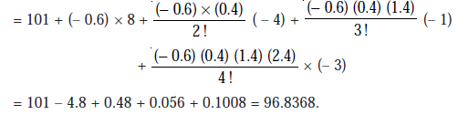
= 96.837 Thousands

Slide 99
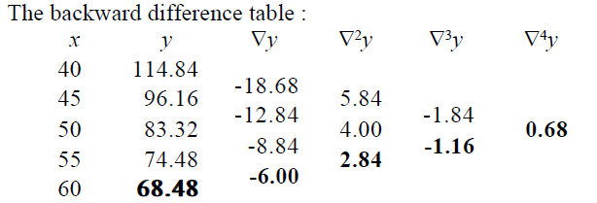
Example 2:
From the following table, estimate the premium for a policy maturing at the age of 58
Age x : 40 45 50 55 60
Premium y : 114.84 96.16 83.32 74.48 68.48

Slide 100
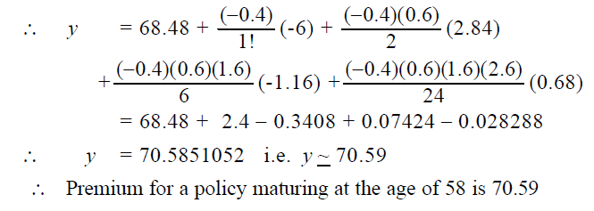
Here,

Slide 101
Lagrange’s Interpolation Formula
This formula can be applied to both equal and unequal intervals.
Let f(x) denote a polynomial of the n^{th} degree which takes the values y₀, y₁, y₂, ..., y_{n} when x has the values x₀, x₁, x₂, ..., x_{n}, respectively.
Here, the values of x are not necessarily equally spaced.

Slide 102
Example1:
Using Lagrange’s formula find the value of y when x = 42 from the following table
x : 40 50 60 70
y : 31 73 124 159
Solution :
By data we have
x0 = 40, x1 = 50, x2 = 60, x3 = 70 and x = 42
y0 = 31, y1 = 73, y2 = 124, y3 = 159
The Lagrange's formula is

Slide 103
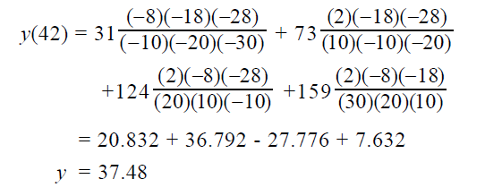

Slide 104
Apply Lagrange’s formula to find the cubic polynomial which includes the following values of x and y.
x : 0 1 4 6
y : 1 -1 1 -1
Solution.
Here x₀ = 0, x₁ = 1, x₂ = 4, x₃ = 6
and y₀ = 1, y₁ = – 1, y₂ = 1, y₃ = – 1
The Lagrange's formula is

Slide 105
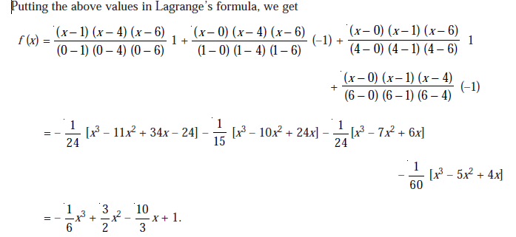

Slide 106
Find the value of y at x = 5 given that:
x : 1 3 4 8 10
y: 8 15 19 32 40
Solution.
Here x0 = 1, x1 = 3, x2 = 4, x3 = 8, x4 = 10
and y0 = 8, y1 = 15, y2 = 19, y3 = 32, y4 = 40
The Lagrange’s interpolation formula is

Slide 107
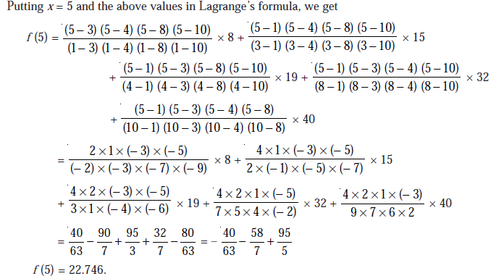

Slide 108
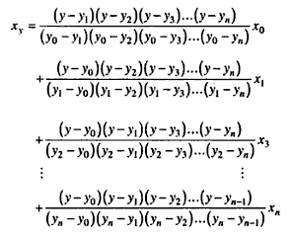
Inverse interpolation
The process of estimating the value of x for the value of y not in the table is called inverse interpolation.
Lagrange's method of interpolation can be used for inverse interpolation by writing the formula similar to interpolation replacing y by x and x by y. In this way, the interpolated value x(y) for a given value y can be obtained by the formula.

Slide 109
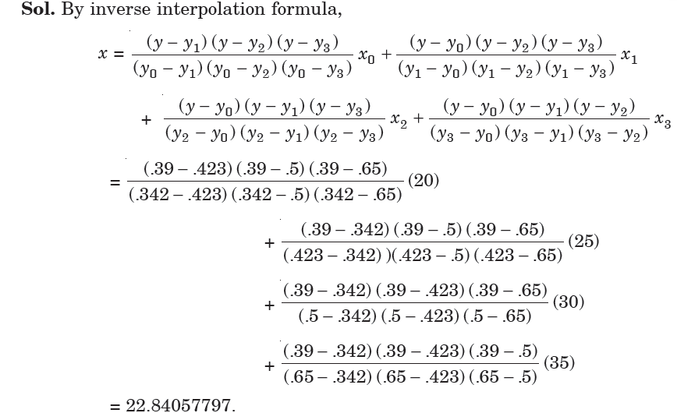
Example: From the given table:
x: 20 25 30 35
y(x): 0.342 0.423 0.5 0.65
Find the value of x for y(x) = 0.390.

Slide 110
Numerical Integration
Introduction: The process of evaluating a definite integral from the set of tabulated values of the integrand f (x) is called numerical integration.
Given a set of data points (x₀, y₀), (x₁, y₁), ..., (x_{n}, y_{n}) of a function y = f(x), where f(x) is not known explicitly.
It is required to compute the value of the definite integral
In this case we have to replace f(x) by an interpolating polynomial φ(x) and obtain an approximate value of the definite integral by integrating φ(x).
Thus, different integration formulae can be obtained depending upon the type of the interpolation formula used.

Slide 111
Trapezoidal Rule
Simpson’s 1/3-Rule
It should be noted that this rule requires the division of the whole range into an even number of subintervals of width h. (or odd number points in the table)

Slide 112
Example
Evaluate
for h= 0.25 and 0.125 using Trapezoidal and Simpson's rule (correct to three decimal places). Verify your answer with exact integration
Solution
The values of x and y are tabulated below h = 0.25
x | 0 | 0.25 | 0.5 | 0.75 | 1
y=f(x) | 1 | 0.8 | 0.6667 | 0.5714 | 0.5
Trapezoidal rule gives

Slide 113
Simpson’s rule gives

Slide 114
Example (Cont.)
Solution
The values of x and y are tabulated below h = 0.125
x | 0 | 0.125 | 0.25 | 0.375 | 0.5 | 0.625 | 0.75 | 0.875 | 1.0
Y=f(x) | 1 | 0.889 | 0.8000 | 0.7273 | 0.6667 | 0.6154 | 0.5714 | 0.5333 | 0.5
Trapezoidal rule gives

Slide 115
Simpson’s rule gives
By exact integration

Slide 116
Example 2
Evaluate using Trapezoidal and Simpson’s rule,
correct to 4 decimal places. Take h= 0.25.Hence obtain the approximate value of
Solution
Trapezoidal rule:
x | 0 | 0.25 | 0.5 | 0.75 | 1
y=1/1+x² | 1 | 0.9412 | 0.8 | 0.64 | 0.5

Slide 117
Simpsons rule:
By actual integration

Slide 118
Example 3
Evaluate
taking n = 6 using Simpson’s 1/3 rule.
Solution:
x₀ = 0, x_{n} = 1.2, n = 6
x | 0 | 0.2 | 0.4 | 0.6 | 0.8 | 1.0 | 1.2
y | 1.0 y0 | 1.22140 y1 | 1.49182 y2 | 1.82212 y3 | 2.22554 y4 | 2.71828 y5 | 3.32012 y6

Slide 119
Example 4: A river is 80 meters wide. The depth ‘d’ in meters at a distance ‘x’ meters from one bank is given by the following table. Find the area of cross section of the river.
Solution:
Here h=10 and n=8
x | 0 | 10 | 20 | 30 | 40 | 50 | 60 | 70 | 80
y | 0 y0 | 4 y1 | 7 y2 | 9 y3 | 12 y4 | 15 y5 | 14 y6 | 8 y7 | 3 y8

Slide 120
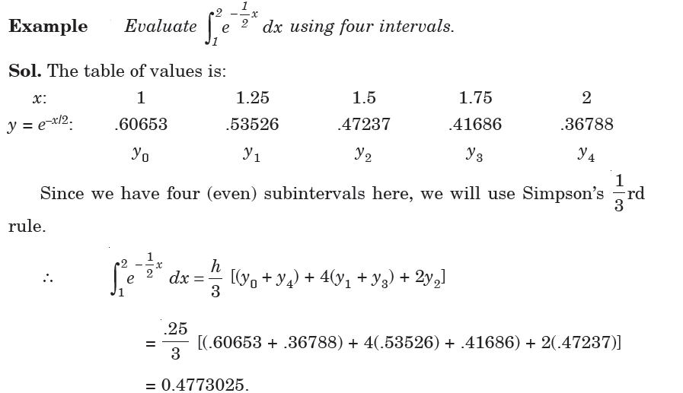

Slide 121
Numerical Solution of Ordinary Differential Equations
Differential equations are very important to solve many science and engineering problems.
An equation that consists of derivatives is called a differential equation.
A differential equation which involves only one independent variable is called ordinary differential equation. For example,
The variable which is being differentiated is called the dependent variable, x in this case, and the variable with respect to which the dependent variable is differentiated is called the independent variable, y in this case

Slide 122
Numerical Solution of Ordinary Differential Equations
To describe various numerical methods for the solution of ordinary differential equation, we consider the general first order differential equation .
CLASSIFICATION OF SOLUTION METHODS
1)Single step or one step methods
Single-step method requires only one preceding value of y (ie) we need only one initial value to start the problem.
Examples :Euler’s method and Runge-kutta methods
2)Multi Step methods or Predictor corrector methods.
Multistep method requires two or more preceding values of y.
(ie) we need more than one initial values to start the problem
Examples: Milne’s and Adam’s predictor corrector methods

Slide 123
Euler’s Formula
This process is very slow.
To obtain reasonable accuracy with Euler’s method, we need to take a smaller value for h.

Slide 124
Example
Solve the differential equation y´ = -y with the initial condition y(0) = 1 and h = .01. by Euler’s method. Compute y(0.04)
Solution: Given
With h = 0.01 gives
y₁ = y₀ + hf(x₀, y₀) = 1 + 0.01(-1) = 0.99
y₂ = y₁ + hf(x₁, y₁) = 0.99 + 0.01(-0.99) = 0.9801
y₃ = y₂ + hf(x₂, y₂) = 0.9801 + 0.01(-0.9801) = 0.9703
y₄ = y₃ + hf(x₃, y₃) = 0.9703 + 0.01(-0.9703) = 0.9606

Slide 125
Example 2:Using Euler's method find the approximate solution of dy/dx= (y - x)/(y + x), y(0) = 1.0 at x = 0.1by taking h = 0.02
Solution: Given
y₁ = y₀ + h f(x₀, y₀) = 1.0 + 0.02* ( (1.0 - 0.0)/(1.0 + 0.0) ) = 1.02 y₂ = y₁ + h f(x₁, y₁) = 1.02 + 0.02* ( (1.02 - .02)/(1.02 + .02) ) = 1.0392 y₃ = y₂ + h f(x₂, y₂) = 1.0392 + 0.02* ( (1.0392 - .04)/(1.0392 + .04) ) = 1.0577 y₄ = y₃ + h f(x₃, y₃) = 1.0577 + 0.02* ( (1.0577 - .06)/(1.0577 + .06) ) = 1.0756 y₅ = y₄ + h f(x₄, y₄) = 1.0756 + 0.02* ( (1.0756 - .08)/(1.0756 + .08) ) = 1.0928

Slide 126
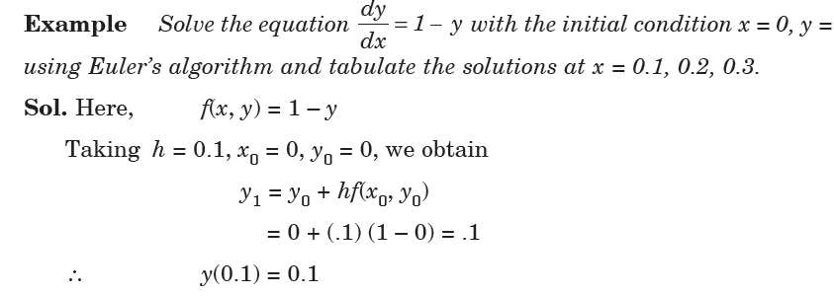
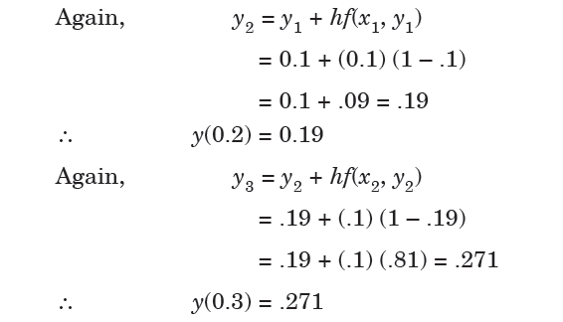

Slide 127
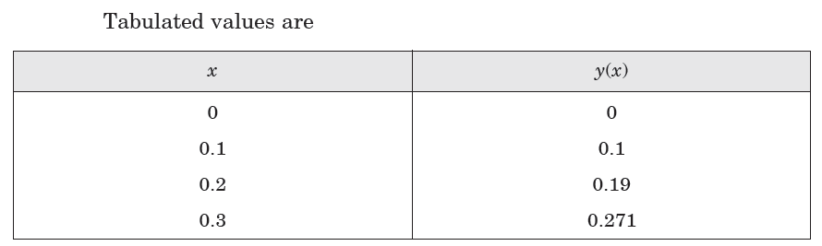

Slide 128
Runge-Kutta Method
Runge-kutta fourth order formula is

Slide 129
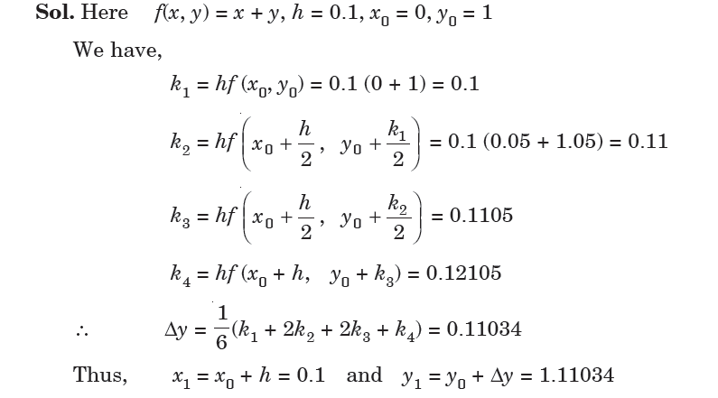
Ans:

Slide 130
